Slide 1

Crypto Trading Bot
Yang Nguyen, Ryan Thackston, Fatemeh Tale, Likhitha Singamsetty, Avisha Singh

Slide 2
Problem
Forecasting Time Series can involve a range of different challenges such as predicting sales for a company, exact prices on stocks, predicting supply chain loads, predicting long-term trends, etc.
Correctly forecasting or predicting bottlenecks and volatility in our economy can increase the efficiency of the markets and make better use of the resources that the economy. When an entity correctly finds volatility in the markets and acts on it, that entity is rewarded and over time more entities will join which creates competition in finding volatility while overall decreasing volatility in the markets over time due to the actions of many making more efficient use of resources.
We want to make a forecasting model that can correctly predicts volatility in the Bitcoin cryptocurrency market and makes the correct decision on when to buy or sell Bitcoin. Correctly predicting this will stabilize the Bitcoin market over time.

Slide 3
Research Question
Can we use a ResNet with Blurpool and Global weight pooling to correctly forecast when to buy, sell, or wait when trading on a Bitcoin-USDT market?
Hypothesis: If we use our model to forecast good times to buy or sell on a volatile market, then we will be able to classify correctly over half the time because our model is finding underlying patterns in the time series data.
We test the correctness of our model by labeling our data as “buy”, “sell”, or “wait”, then comparing how our model predicts testing data vs. the initial labels made on the same data.

Slide 4
Initial Research
We looked at previous research to better understand the field of forecast modeling.
What immediately stood out to us was the M1-M4 dataset competitions and research of Spyros Makridakis et al. [1] [2] [5]
The M1-M4 dataset competitions are comprised of different forecasting problems to solve and the different forecast models using statistical and machine learning methods to solve these problems.

Slide 5

Acquiring the Data
Got signed up on Bitfinex
Created an API and wrote script to obtain trading data of BTC-USDT from June 1, 2021 to November 30, 2021
BTC-USDT prices in 1-minute intervals for a total of over 260,000 data points.
Recorded from the data are the Open/Close/High/Low/Volume

Slide 6
Preprocessing Pipeline
Threshold is median volatility.
If Above Threshold
Load the Data
Time Window Data
Perform GARCH
Perform ARIMA
Label each variable buy/hold/sell
Make buy/sell
Decision based on ARIMA Forecast
1D CNN
If Below Threshold, Hold

Slide 7
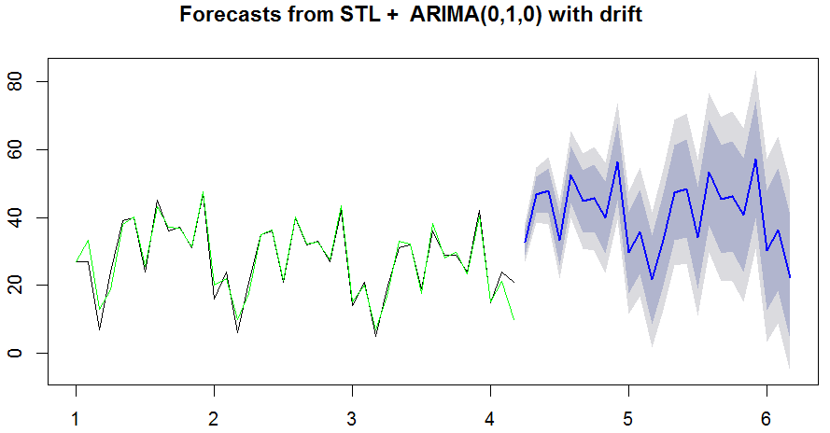
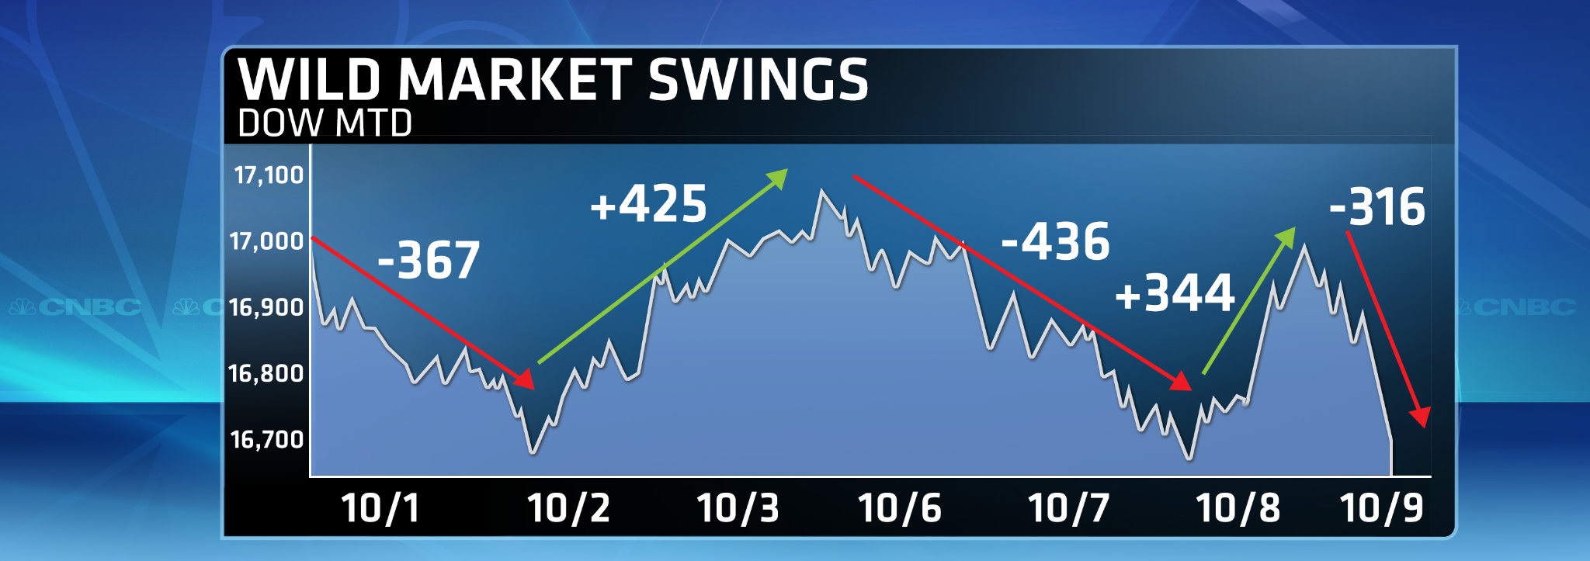
ARIMA
GARCH
Statistical method that creates a trendline of past data in order to forecast future values.
ARIMA: Auto-Regressive Integrated Moving Average
Forecasts farther in the future are less predictable.
Statistical Method that measures market volatility through variance
Generalized Auto-Regressive Conditional Heteroskedasticity
Volatility in the market (variance is higher than average) means it’s a good time to buy or sell.

Slide 8
CNN Squeeze Excitation Block
Input tensor after 2nd Conv1D from Residual Block
[B, L, C]
Store as Xi
Global Weight Avg Pooling 1D
Fully Connected Layer
Swish
Fully Connected Layer
Sigmoid
Multiply Xi
Output tensor
[B, C, L]

Slide 9
CNN Pipeline Residual Block
Input tensor after 2nd Conv1D from Residual Model
[B, L, C]
Store as Xn
Batch Norm
Swish
Store output as Xa
Yes
If n<2
SE Block
No
Conv1D
Conv1D
If dim match
input
Add Xn
Yes
No
Go to store output as Xa
Add Xn
BlurPool
Output tensor
[B, L, C]
Output tensor
[B, L, C]
BlurPool

Slide 10
CNN Pipeline Residual Model
Input tensor
[B, L, C]
Conv1D
BatchNorm
Swish
BlurPool
If n<3
BlurPool
No
Residual Block [n]
Conv1D
Fully Connected Layer
Global Weight Max Pooling 1D
Yes
Softmax
Output tensor
[B, L, C]

Slide 11
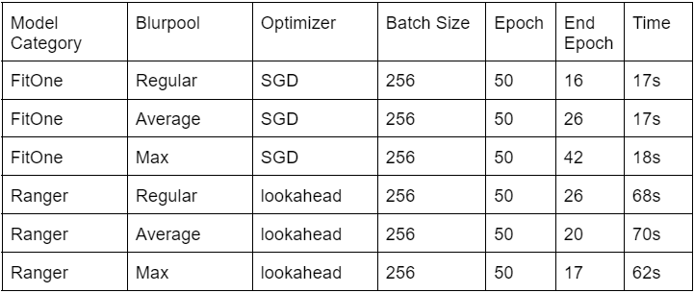
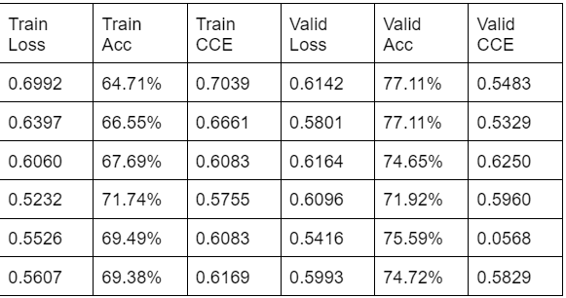
Results

Slide 12
Conclusion
Using ARIMA and GARCH for our pre-processing as well as deciding our labels for data classification appeared to do well for training our model. We have found no other papers thus far that use this for a labeling scheme.
We learned that FitOneCycle allows the model to train significantly faster because it searches for the best optimal learning rate while training
We also learn that the loss from Lookahead optimizer is lower than Stochastic Gradient Descent
Able to obtain 65-70% in training accuracy and 70-78% in validation Accuracy with our customized Resnet Model

Slide 13
References
[1] S. Makridakis, E. Spiliotis, V. Assimakopoulos, “Statistical and Machine Learning forecasting methods: Concerns and Ways Forward”, PLOS One, 2018
[2] S. Makridakis, “The M4 competition: 100,000 time series and 61 forecasting methods”, PLOS One, 2019
[3] H. Hewamalage, C. Bergmeir, K. Bandara “Recurrent Neural Networks for Time Series Forecasting: Current status and future directions” International Journal of Forecasting, 2020
[4] S. Smyl “A Hybrid Method of Exponential Smoothing and Recurrent Neural Networks for Time Series Forecasting”, International Journal of Forecasting, 2019
[5] E. Spiliotis, V. Assimakopoulos, S. Makridakis “Generalizing the Theta method for automatic forecasting” European Journal of Operational Research, 2020
[6] D. Salinas, V. Flunkert, J. Gasthaus, T. Januschowski, “DeepAR: Probabilistic Forecasting with Autoregressive Recurrent Networks”, Amazon Research Germany, 2020
[7] S. McNally, J. Roche, S. Caton, 2018. Predicting the Price of Bitcoin Using Machine Learning. Proc. - 26th Euromicro Int. Conf. Parallel, Distrib. Network-Based Process. PDP 2018 339–343.
[8] L. Horv, P. Kokoszka, 2003. GARCH processes: structure and estimation. Bernoulli 9, 201–227.
[9] K. He, X. Zhang, S. Ren, J. Sun., 2016. Deep residual learning for image recognition. Proc. IEEE Comput. Soc. Conf. Comput. Vis. Pattern Recognit. 2016–December, 770–778.

Slide 14
References
[10] J. Hu, L. Shen, S. Albanie, G. Sun and E. Wu, "Squeeze-and-Excitation Networks," in IEEE Transactions on Pattern Analysis and Machine Intelligence, vol. 42, no. 8, pp. 2011-2023, 1 Aug. 2020.
[11] P. Colarusso, L.H. Kidder, I.W. Levin, E. Neil Lewis, 1999. Raman and Infrared Microspectroscopy, in: Lindon, J.C.B.T.-E. of S. and S. (Ed.), . Elsevier, Oxford, pp. 1945–1954.
[12] R. Zhang, “Making Convolutional Networks Shift-Invariant Again” presented at 36th International Conference on Machine Learning, Long Breach, California, Jun 2019.
[13] S. Qiu, “Global Weighted Average Pooling Bridges Pixel-level Localization and Image-level Classification”, arXiv, Sep 2018.
[14] M. Zhang, J. Lucus, G. Hinton, and J. Ha, “Lookahead Optimizer: k steps forward, 1 step back” ” presented at 33rd Conference on Neural Information Processing Systems, Dec 2019.
[15] L. Smith, “A Disciplined Approach to Neural Network Hyper-Parameters: Part 1 - Learning Rate, Batch Size, Momentum, and Weight Decay” ” US Naval Research Laboratory Technical Report, April 2018.
[16] H. Yong, J. Huang, X. Hua, L.Zhang, “Gradient Centralization: A New Optimization Technique for Deep Neural Networks”, arXiv, Sep 2018.
[17] P. Ramachandran, B. Zoph, Q. Le, "Searching for Activation Function," arXiv Google Brain, 27 Oct. 2017
[18] Lo, Andrew W “The Statistics of Sharpe Ratios” in Financial Analysts Journal, January 02, 2019

